Slide 1
Autoencoders Part B

Slide 2
Outline
What are autoencoders?
Brief history of encoding/decoding.
Inside autoencoders.
Convolutional autoencoders.
Regularization of autoencoders.
Applications
Denoising
Blending

Slide 3

Autoencoder with fully connected layers
Check again if the deep AE trained on MNIST works with “Pavlos” image?
512 neurons
256 neurons
20 neurons
256 neurons
512neurons
784 neurons
NO
Since we are dealing with images, it is best to use CNNs

Slide 4
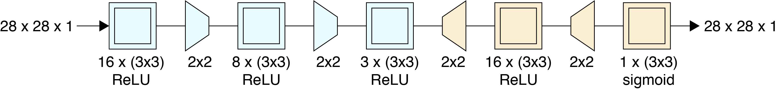
Convolutional Autoencoders
16 filters (3x3x1) same padding
Output: 28x28x16
8 filters (3x3x16) same
Output: 14x14x8
3 filters (3x3x8) same
Output: 7x7x3
Max pooling 2x2
Output: 14x14x16
Max pooling 2x2
Output: 7x7x8

Slide 5
Convolutional Autoencoders
16 filters (3x3x1) same padding
Output: 28x28x16
8 filters (3x3x16) same
Output: 14x14x8
3 filters (3x3x8) same
Output: 7x7x3
Max pooling 2x2
Output: 14x14x16
Max pooling 2x2
Output: 7x7x8
But how can we increase the dimensions of the conv layers? Upsampling!

Slide 6
Convolutional Autoencoders
1 filter (3x3x16) same
Output: 28x28x1
Upsampling 2x2
Output: 14x14x3
16 filters (3x3x3) same
Output: 14x14x16
3 filters (3x3x8) same
Output: 7x7x3
Upsampling 2x2
Output: 28x28x16

Slide 7
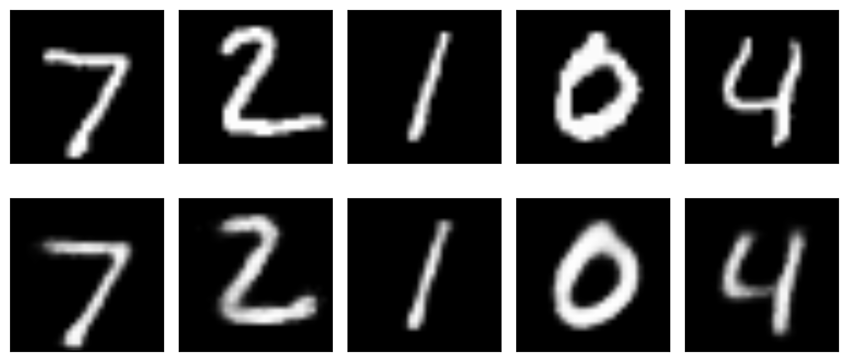
Convolutional Autoencoders
Original Images
Reconstructed Images with DeepFCN AE

Slide 8
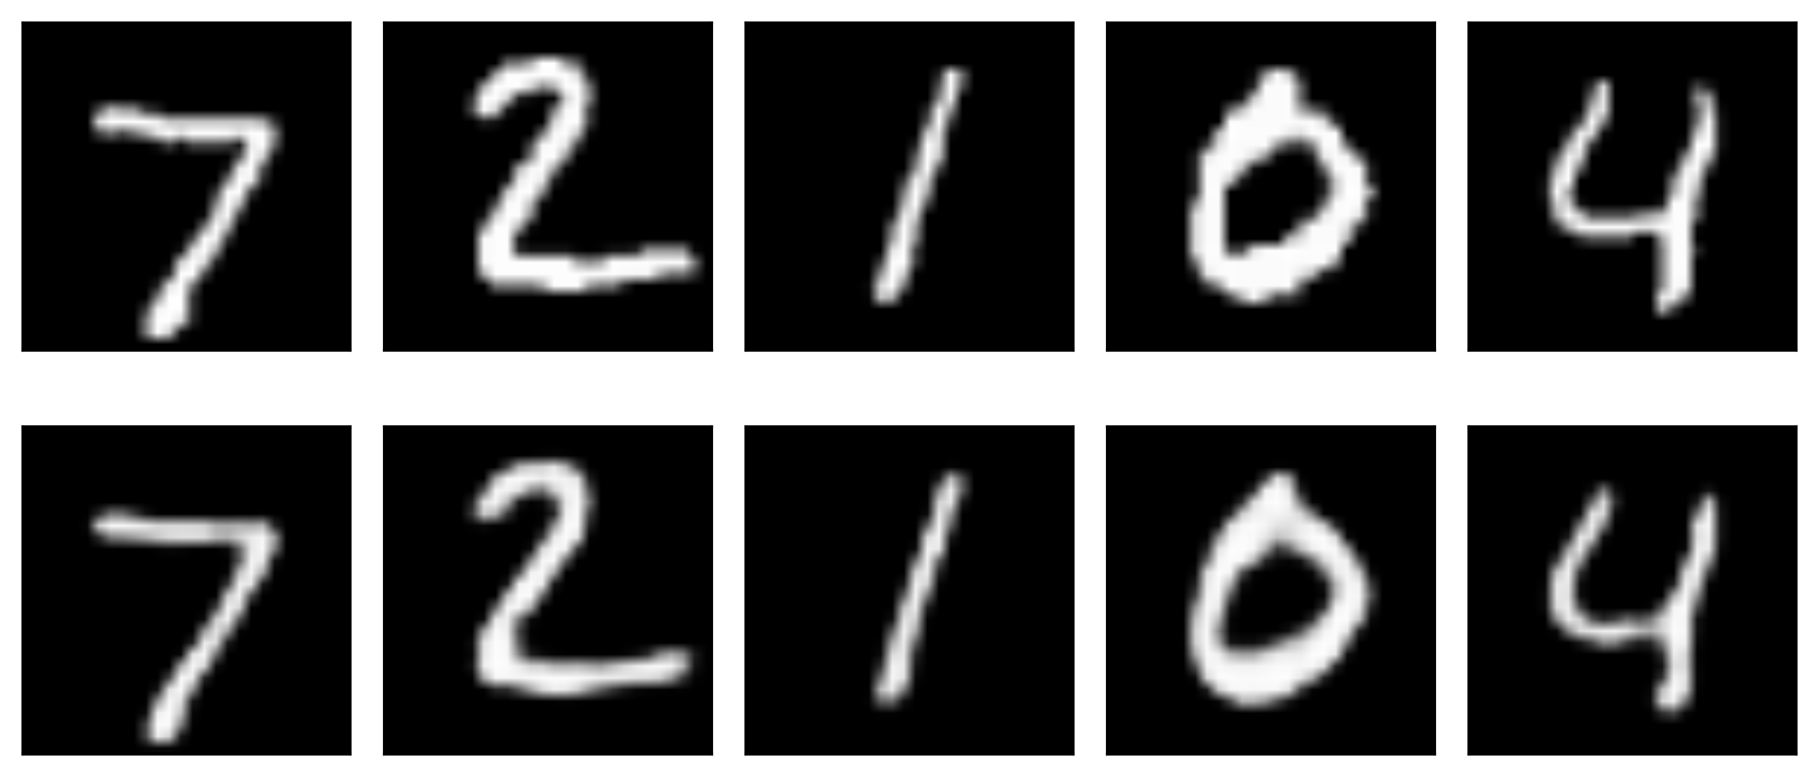
Convolutional Autoencoders
Original Images
Reconstructed Images with Conv AE

Slide 9
Regularization of Autoencoders
Sparse autoencoders
Contractive autoencoders
Denoising autoencoders

Slide 10
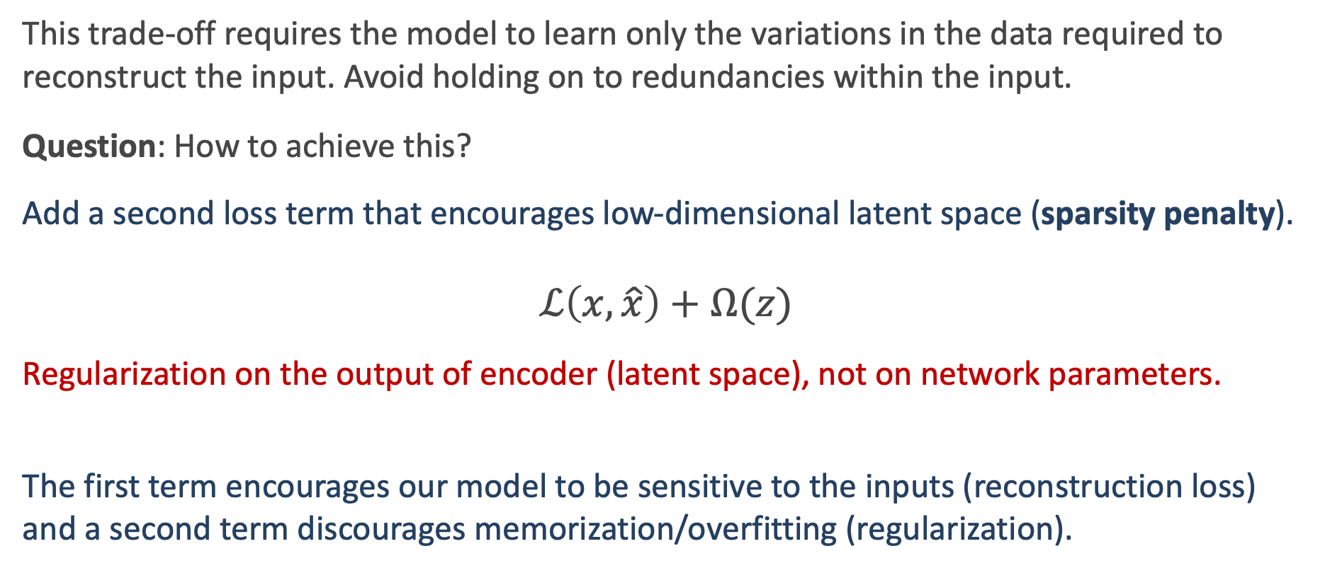
Sparse Autoencoders
This trade-off requires the model to learn only the variations in the data required to reconstruct the input. Avoid holding on to redundancies within the input.
Question: How to achieve this?
Αdd a second loss term that encourages low-dimensional latent space (sparsity penalty). $$ℒ\left(x,\hat{x}\right)+Ω(z)$$
Regularization on the output of encoder (latent space), not on network parameters.
The first term encourages our model to be sensitive to the inputs (reconstruction loss) and a second term discourages memorization/overfitting (regularization).

Slide 11
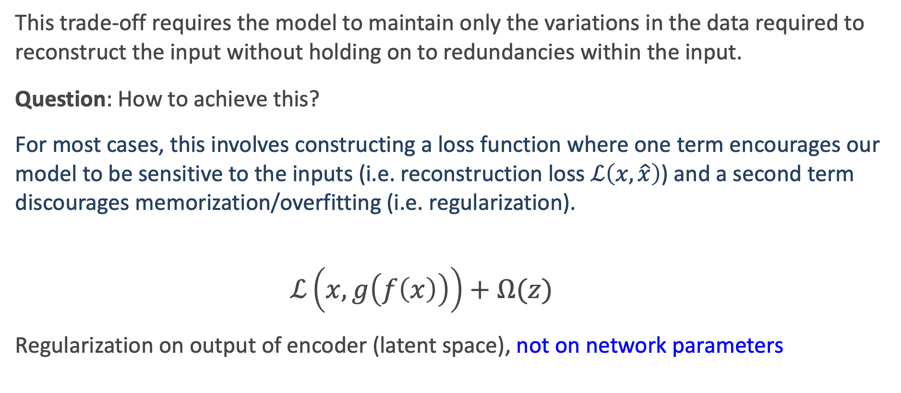
Sparse Autoencoders
This trade-off requires the model to maintain only the variations in the data required to reconstruct the input without holding on to redundancies within the input.
Question: How to achieve this?
For most cases, this involves constructing a loss function where one term encourages our model to be sensitive to the inputs (i.e. reconstruction loss $ℒ\left(x,\hat{x}\right)$) and a second term discourages memorization/overfitting (i.e. regularization).
$$ℒ\left(x,g\left(f\left(x\right)\right)\right)+Ω(z)$$
Regularization on output of encoder (latent space), not on network parameters

Slide 12
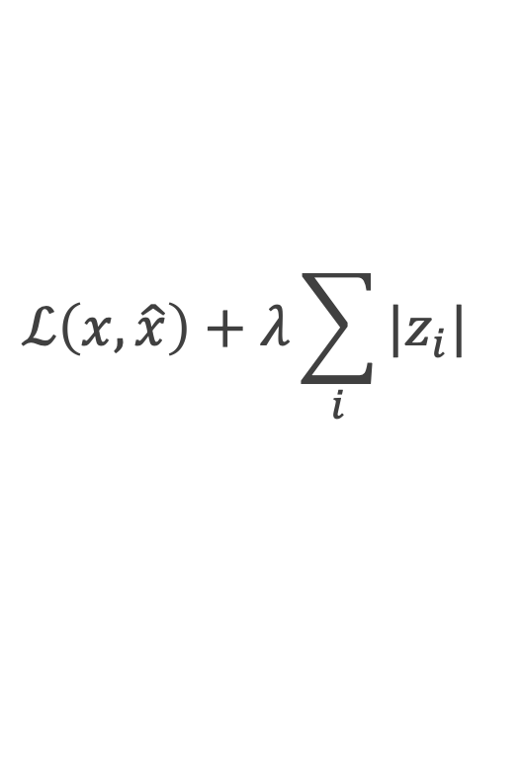
Sparse Autoencoders
Apply an L1 regularization on the bottleneck activated neurons (latent space)
$$ℒ\left(x, \hat{x}\right)+λ\sum_{i}{|z_{i}|}$$
We ask the AE to have the lowest possible dimensional latent space that is sufficient to reconstruct the input data.
Limit the network's capacity to memorize the input data without limiting the networks capability to extract features from the data.
Individual regions of the AE are selectively activated depending on the input. Each region takes care of a specific attribute of the input data.
Notes:
More robust AE

Slide 13
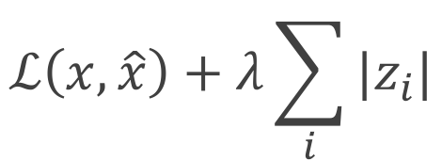
Sparse Autoencoders
We allow our network to sensitize individual hidden layer nodes toward specific attributes of the input data.
A sparse autoencoder is selectively activate regions of the network depending on the input data.
Limiting the network's capacity to memorize the input data without limiting the networks capability to extract features from the data.
$$ℒ\left(x, \hat{x}\right)+λ\sum_{i}{|z_{i}|}$$

Slide 14
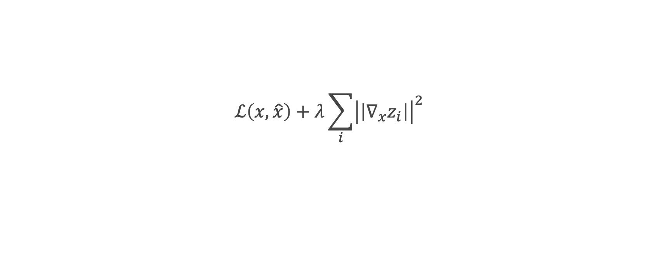
Contractive Autoencoders
Intuitively, we would expect that for very similar inputs, the learned encoding would also be very similar.
In other words, we want the latent space to not change a lot when the input data slightly changes.
How can we assist the AE to do that?
Derivatives! Remember the saliency maps
Apply an L2 regularization on the derivatives of the latent variables
$$ℒ\left(x,\hat{x}\right)+λ\sum_{i}{{\left|\left|∇_{x}z_{i}\right|\right|}^{2}}$$
Notes:
To be robust (non sensitive) in small variations of the input data
We can explicitly train our model in order for this to be the case by requiring that the derivative of the hidden layer activations are small with respect to the input.

Slide 15
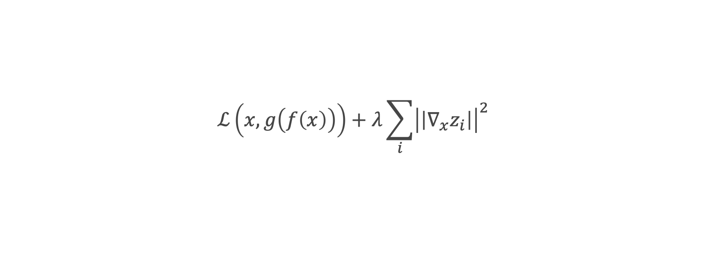
Contractive Autoencoders
Derivatives
$$ℒ\left(x,g\left(f\left(x\right)\right)\right)+λ\sum_{i}{{\left|\left|∇_{x}z_{i}\right|\right|}^{2}}$$
This forces the model to learn a function that does not change much when x changes slightly. Because this penalty is applied only at training examples, it forces the autoencoder to learn features that capture information about the training distribution.
Notes:
We can explicitly train our model in order for this to be the case by requiring that the derivative of the hidden layer activations are small with respect to the input.

Slide 16
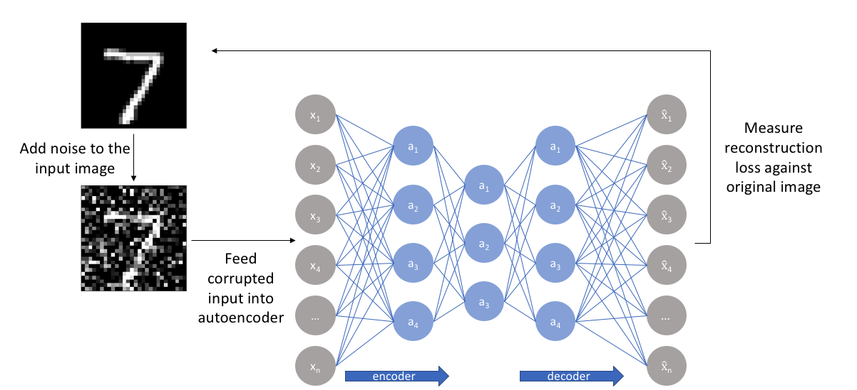
Denoising Autoencoders
Make the AE predictions non-sensitive to noise input images
We feed an AE with noisy data point (input) and and train to predict the original
For each epoch:
Add noise to the input image
Forward the noisy image through the AE
Calculate the reconstruction loss with the original image

Slide 17
Applications of Autoencoders
Denoising images
Blending

Slide 18
Denoising images
A popular use of autoencoders is to remove noise from samples.
Start with a pristine image
Measure reconstruction loss against pristine image
Add noise to to the input images
Feed corrupted input into autoencoder

Slide 19
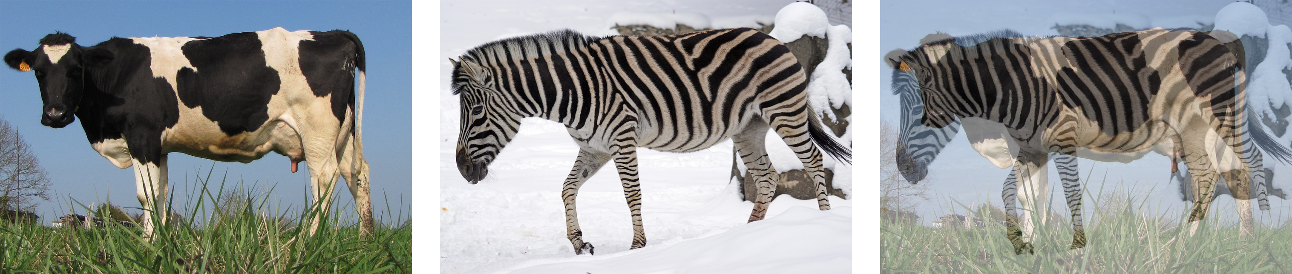
Blending
We blend inputs to create new data that is similar to the input data, but not exactly the same.
One example is the content blending where the content of two pieces of data is directly blended. An example is if we overlay images of a cow and zebra.
Image taken from A. Glassner, Deep Learning, Vol. 2: From Basics to Practice
Notes:
But we want to learn the essence: Zebra -> stripes , Cow -> big

Slide 20
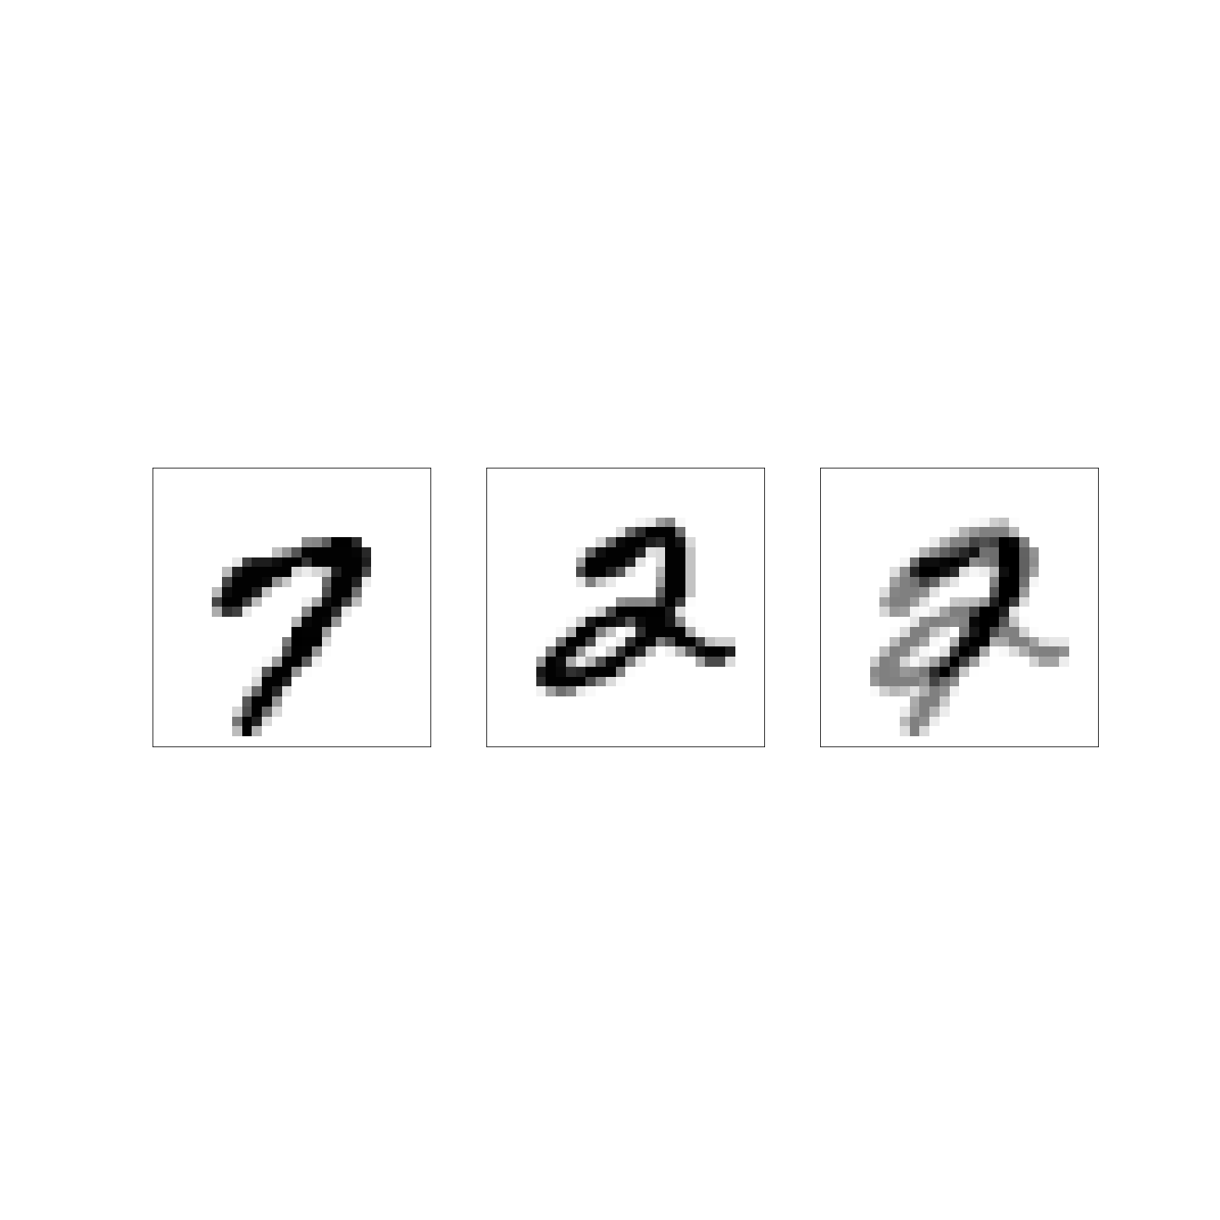
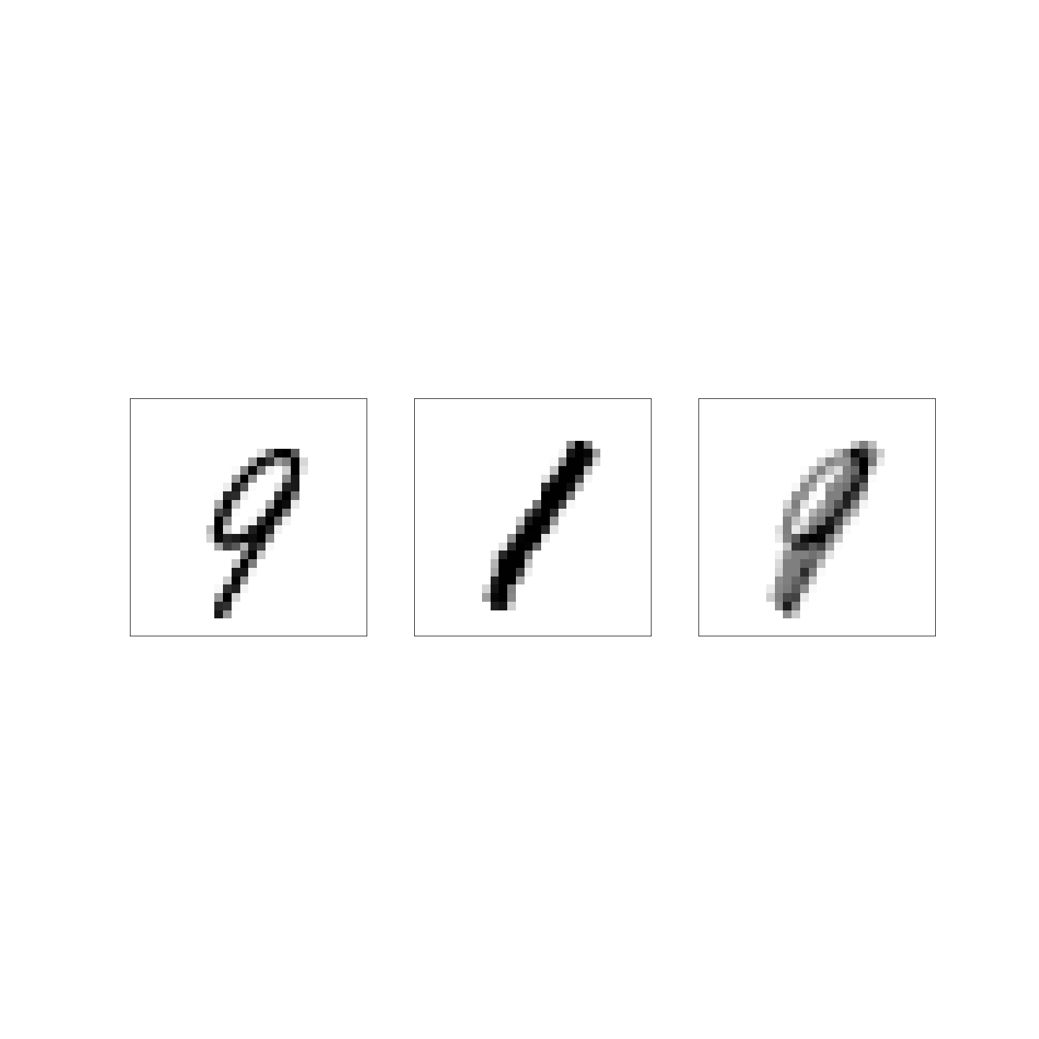
Content Blending
Content blending on MNIST images
Image taken from A. Glassner, Deep Learning, Vol. 2: From Basics to Practice

Slide 21
Representation blending
Another type of blending is representation blending:
In this type of blending, we take advantage of the contextual learning to describe the objects we are interested in. By engaging in blending in the latent (parameter) space, we create data that blend the essence or the inherent qualities of the objects of interest.
Notes:
parametric blending

Slide 22
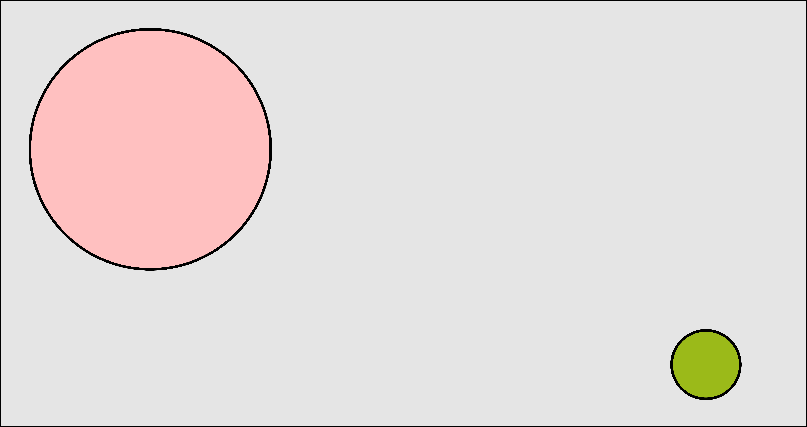
Representation blending (cont)
Image taken from A. Glassner, Deep Learning, Vol. 2: From Basics to Practice
Notes:
Content blending

Slide 23
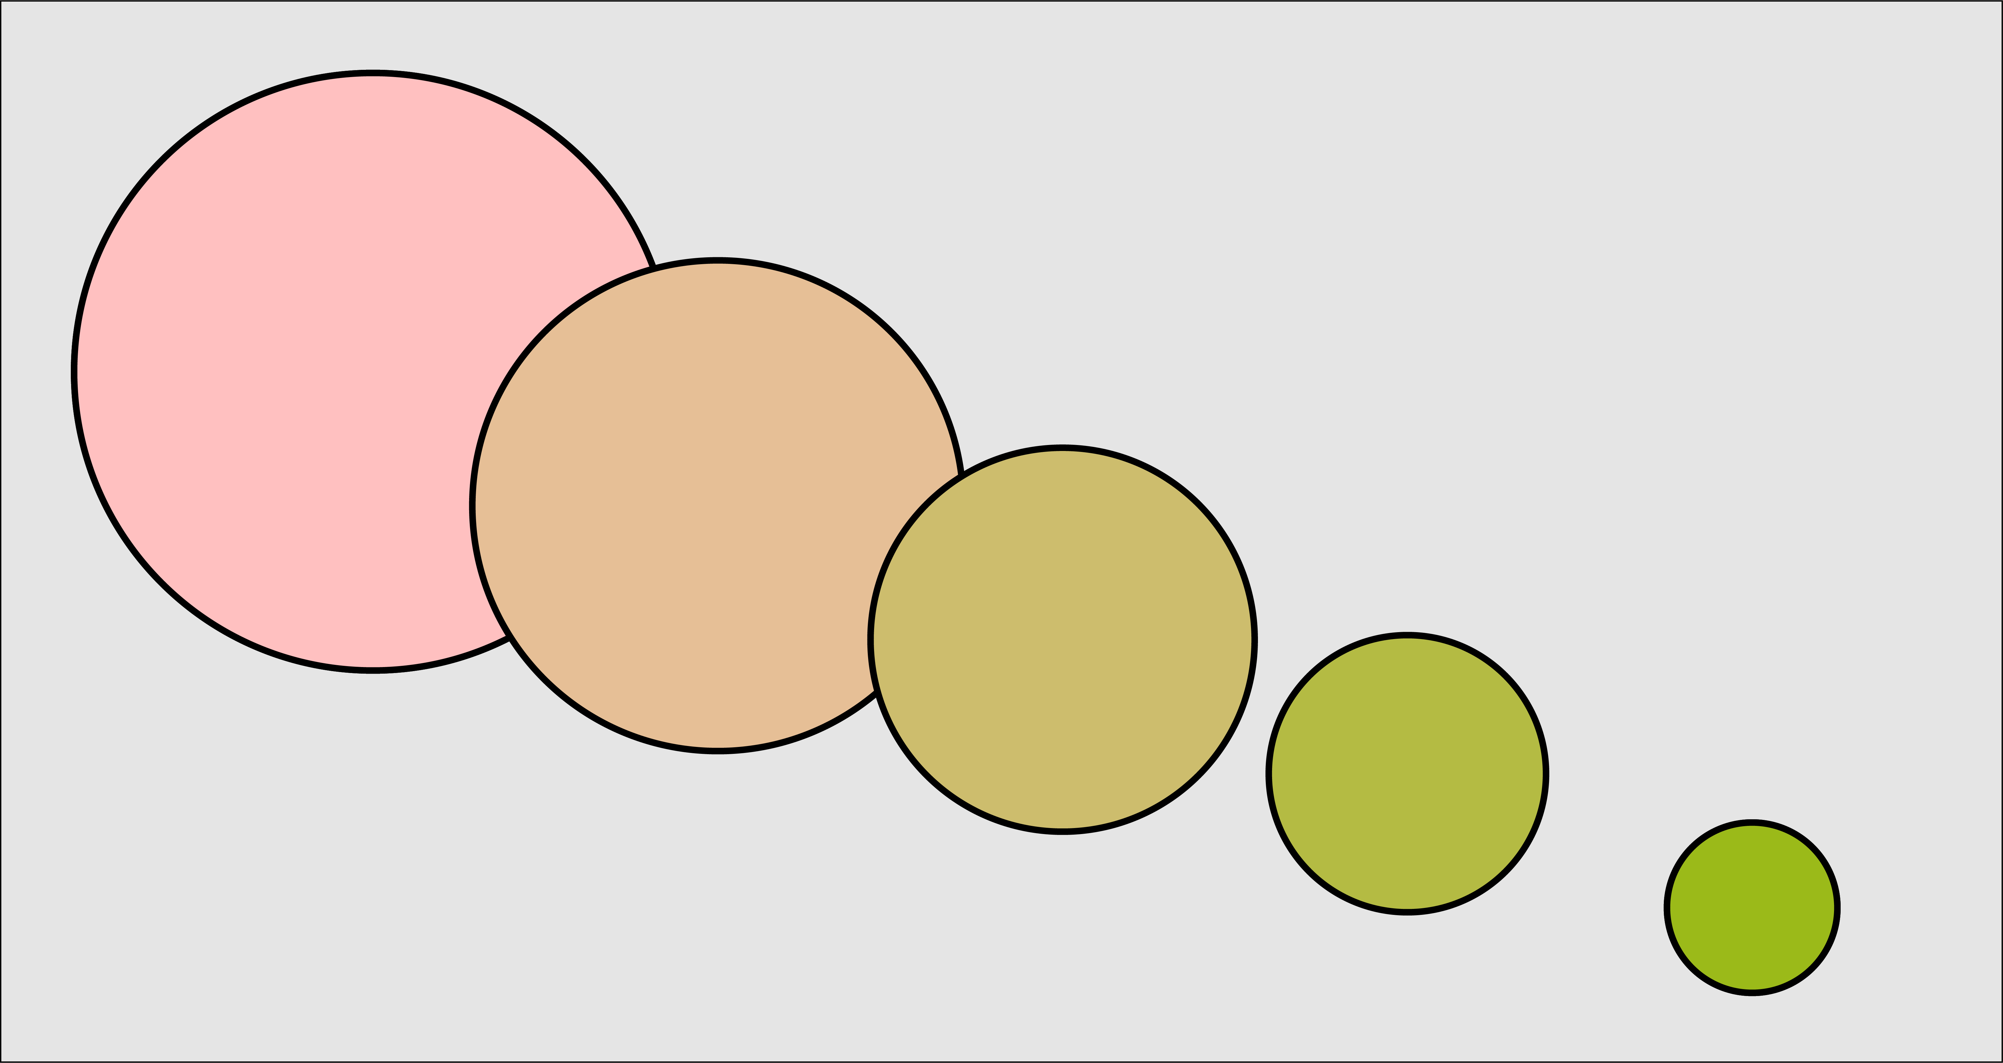
Representation blending
Image taken from A. Glassner, Deep Learning, Vol. 2: From Basics to Practice

Slide 24
Blending Latent Variables
Back to the example of MNIST.
We start at the start of the arrows in latent space and then move to end of the arrow in 7 steps.
For each value of Z we use the already trained decoder to produce an image.
Image taken from A. Glassner, Deep Learning, Vol. 2: From Basics to Practice

Slide 25
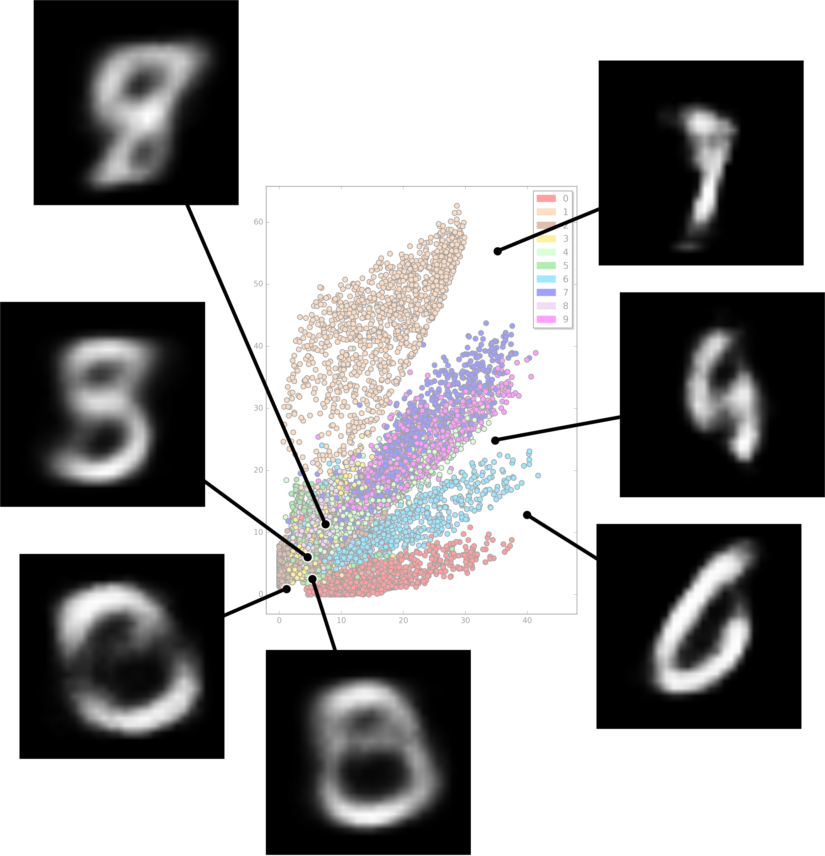
Problems with Autoencoders
Discrete latent space
The latent space contains a lot of gaps (separability)
The cure: Variational autoencoders (VAE)

Slide 26
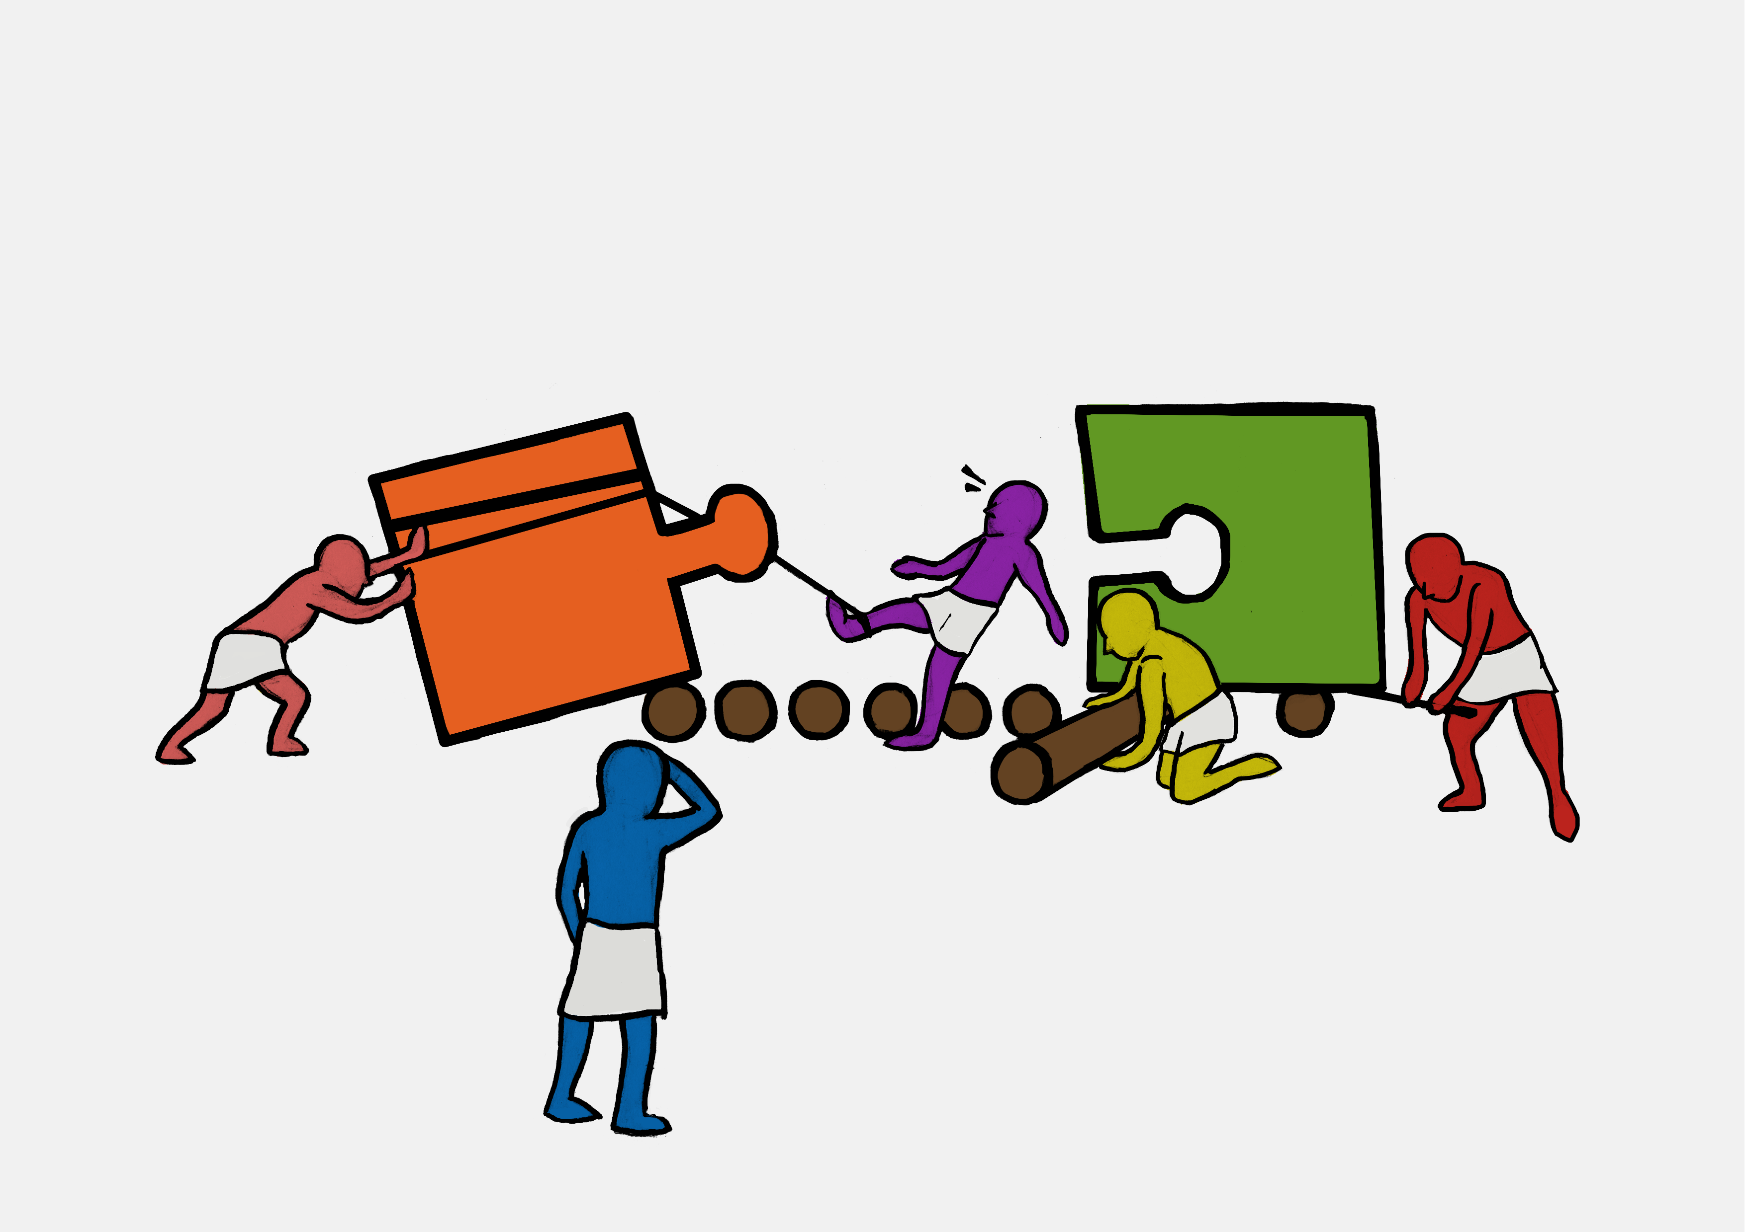
Exercise 2:
Recreating an image of Pavlos

